Slide 1
Comms – Direct
Capgemini’s Telco Rapid Cloud Solution on Oracle

Slide 2
What we hear from the Telco customers......
We need to simplify our Business
We are not able to respond to the market needs with our existing IT Platform
We don’t have a Capital Budget to run big transformation programs
We need reduced and predictable operating costs
We don’t have the skills in-house
We need to act now and show results in months rather than years
We need to improve customer experience
We need to transform the business, but we don’t “know how”

Slide 3
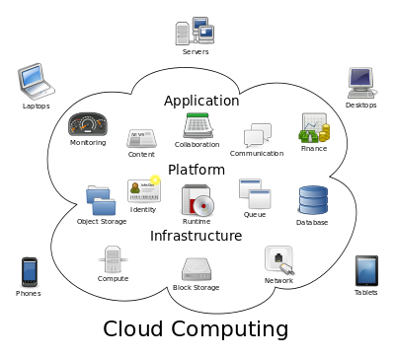
What is Cloud Computing? What is RODOD?
Cloud computing allows application software to be operated using internet-enabled devices. Cloud computing relies on sharing of resources to achieve coherence and economies of scale, similar to a utility (like the electricity grid) over a network. At the foundation of cloud computing is the broader concept of converged infrastructure and shared services..
RODOD- Rapid Offer Design and Order Delivery
Application: RODOD as a product-based and pre-integrated solution allows you to accelerate design and delivery of products, services, and bundles across multiple channels rapidly and accurately to improve customer satisfaction.
It is a Business Suite of applications primarily based on Siebel CRM, OSM, BRM & AIA

Slide 4
Key Drivers
Offer a light weight & low cost alternative E2E solution to the Oracle RODOD Framework for Tier 3 & Tier 4 Telco customers targeted towards next gen subscription based services like Broadband, VOIP, IP TV, Mobile Services etc.
Increase sales force adoption with a simple, easy-to-use UI tailored to Sales Reps and Sales Executives & multi channel experience over cloud platform
Complete customer lifecycle management including Concept to Cash and Unified Customer and Billing Care
Offer rich & robust functionality around Analytics, Mobility & Security
Why Cloud for Telco
The cloud based RODOD - Lite solution will be up running instantly allowing “Look and Feel” early in the journey towards simplified and standardized business operations
Traditional cloud benefits such as minimized upfront investment, reduced TCO, Pay as you go, continuous functional upgrades as the solution evolves
Minimized Risk: Early success or fast failure
Tbaytel (Canada) & AT&T potential clients in this regard with whom we are collaborating

Slide 5
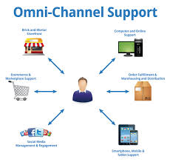
Solution Architecture (RODOD - Lite for Telco)
Customer Relationship Management
CRM
Sales Cloud
Customer Mgmt
Products (Basic Setup)
Sales (Oppty, Leads)
Assets
Customer Relationship Management
OBIEE
ESB
Incident Mgmt
Service Cloud
Customer Relationship Management
Reports
Order Decomposition
BRM
Customer Sync
Knowledge Base
Customer Center
Billing
Products
Billing Order Provisioning
Customer Relationship Management
Order Mgmt
CPQ
Invoicing
Revenue Follow up
Quote\Order Entry
Asset Creation
Quote Mgmt
Products
Order Orchestration
Order Provisioning Systems
Order Submit
Pricing
Order Mgmt
Technical Order Provisioning
Order Completion

Slide 6
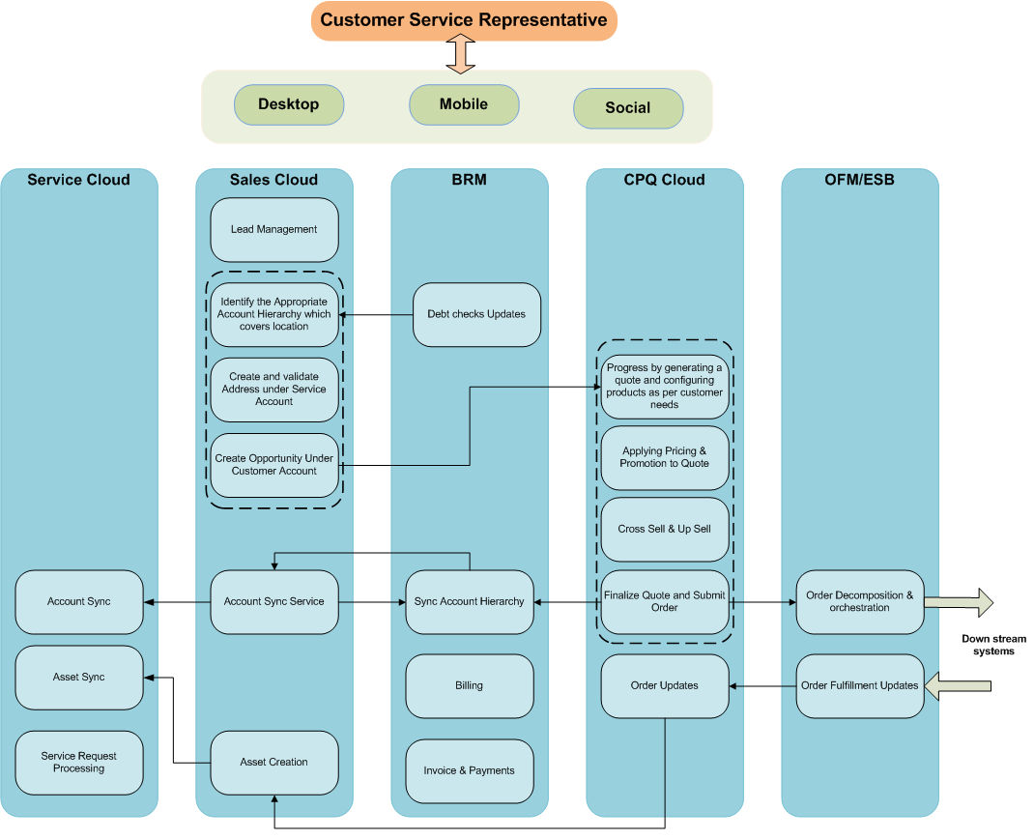
Order to Cash to Care – Business Process Flow

Slide 7
Order to Cash Business Services Solution
New Sales Order
Sales
Sales Cloud
Identify Account Hierarchy
Create Service Address under Account
Create Opportunity
Account Sync Service
Create Customer Assets
A
ICS
ICS
CPQ
Create Quote
Finalize Quote & Generate Order
Submit Order
Update Order
CPQ Cloud
Configuration, Costing & Pricing
Cross & Up Sell
ICS
Order
Lifecycle
Management
Orchestrate Order: Transform / Enrich Order; Decompose & Route Order Components
OFM/ESB
Transform / Enrich Order
Decompose Order, Route Order Components & Listen to Responses and Updates
Order Status Management
O2C
Sync Customer
Initiate Billing
Update Order &
Status
O2C
O2C
Billing
BRM
Debt Checks & Updates
Sync Account Hierarchy
Invoice & Payments
A
Downstream
Systems
Order Provisioning
Legend
Application Activity
ICS
Integration
Cloud Service
Flow
Activity
O2C
Communications Order to Cash

Slide 8
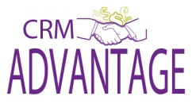
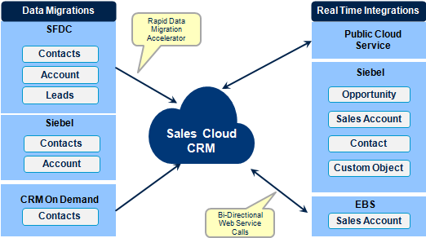
Leverage & Enrich CRM Advantage
Oracle Sales Cloud
Knowledge & experience gained from CRM Advantage will be used optimally for this solution
Solutions built for Telco offering will be used to enrich & expand the CRM Advantage solutions
Sales Planning
Sales Predictor
Forecast Management
Territory Management
Partner Management
Incentive Compensation
Quota Management
Sales Management
Lead Management
Opportunity
Management
Sales Campaigns
Mobile Sales
Reporting & Analytics
Desktop (MS Outlook) Integration
Data Migration Accelerators
Real Time Integrations
Error Handling Framework
Workload Based Assignments
Not available
OOTB
Configured OOTB modules to form E2E Solution Flow

Slide 9
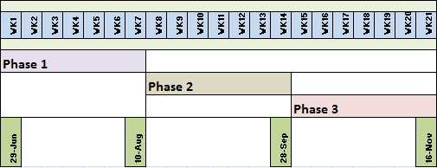
Timelines & Benefits to Capgemini
Basic Integrated solution planned to be available after Phase 2 (end of Q3 2015)
Phase 3 & ahead will focus on augmenting it with more complex functionality over the base soln.
There will be a Phase Zero for 3 weeks focusing on procuring of environments, licenses & resources as well as elaboration of the high level requirements.
This implementation will help to add significant value to our CRM Advantage offering as well as help build our capability since our team has not worked on couple of these cloud products and their integration with Sales Cloud

Slide 10
Solution Implementation Approach
Phase I
Account, Leads & Opty Management for desktop & mobiles
Customer sync between Sales Cloud & BRM
Reports & Mobilytics for Sales Cloud
Phase 2
Asset Mgmt & Reporting in Sales Cloud & basic integration with Service & CPQ Cloud
Products, Pricing, Quotes & Order Mgmt in CPQ Cloud & Incident Mgmt in Service Cloud
Phase 3
Complex order mgmt functionality - modify, suspend, resume & disconnect orders.
Invoicing & Payments
Order Fulfillment & Provisioning
Creation of incidents in Sales Cloud & Opportunities in Service Cloud
Integration of Sales Cloud with OBIEE
Future roadmap
Integration of all clouds with OBIEE & Mobiles / Tablets
CTI & Social Integration for Sales & Service Clouds
Introduce Marketing Cloud in the CX Cloud solution

Slide 11
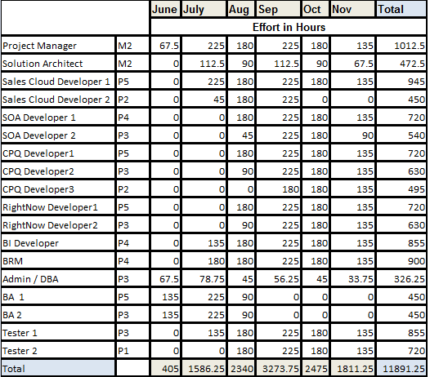
Proposed Staffing & Budget
Total Effort - 11,892 hours
Budgeted Cost - $102,420
Note – The above cost is only for staffing requirements. It does not include other costs like Environment, licenses etc.

Slide 12
Risks & Dependencies
Risks
Delay in procuring the specific environments based on planned dates may impact timelines.
Delay in procuring the skilled resources based on planned dates may impact timelines.
Lack of past experience in areas like CPQ & Service Cloud
Lack of past experience in integrating CX Cloud applications as well as their integration with OBIEE
Any unanticipated & unresolved blocking issues or product limitations from Oracle may requiring replanning the scope & timelines.
Staffing of niche skills like RightNow, CPQ Cloud (BigMachines) & BRM by planned dates.
Not much visibility on Oracle’s solution for Comms industry. May lead so some future realignment.
Dependencies
Two instances of dedicated environments & Licenses for each of the below applications (with ETA)
Sales Cloud - 22 June
CPQ Cloud (Big Machines) – 20 July
Service Cloud (RightNow) – 20 July
BRM – 22 June
Fusion Middleware – 20 July
OBIEE – 22 June
Availability of dedicated resources based on planned dates as per proposed timelines

Slide 13
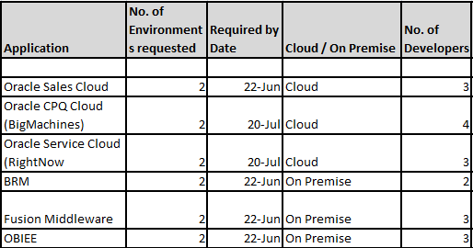
Environment Dependencies

